Slide 1
Week7 Project
Kaiye Chen

Slide 2
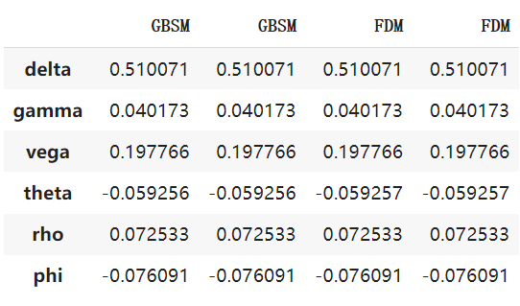
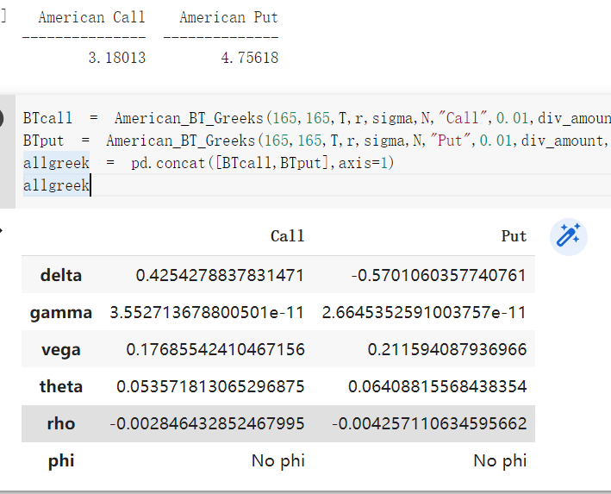
Problem1: Results
B-S-M and Finite Difference: Very similar Greeks
N increases, Put-Call Spread decreases

Slide 3
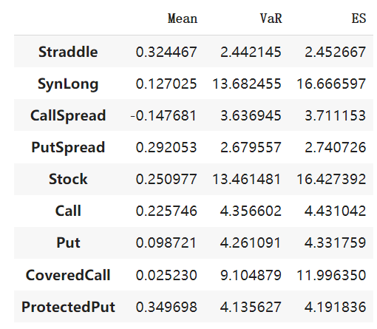
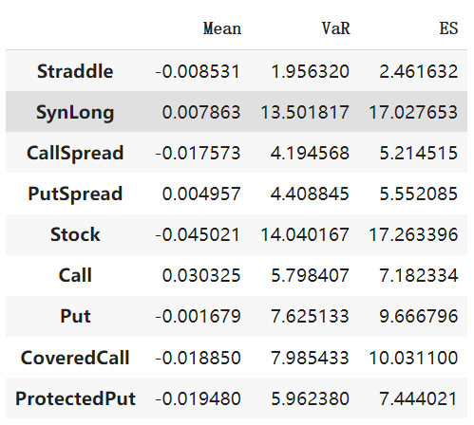
Problem2: Delta Hedge Results
Delta Hedge: Make means close to 0
Gamma and others: mean not exactly 0
Risk metrics: No large difference

Slide 4
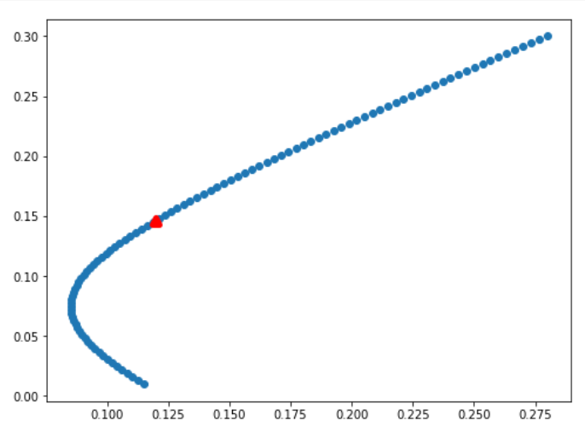
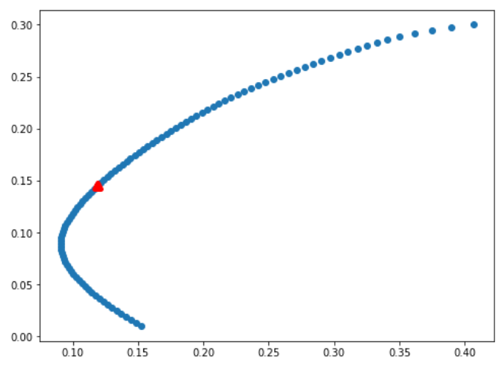
Problem3: Efficient Frontier
Optimize method: Minimize volatility and Maximize Sharpe Ratio
Optimize sharpe: 1.19, very close
Distribution: No shortsell portfolio more sparse when return high

Slide 5
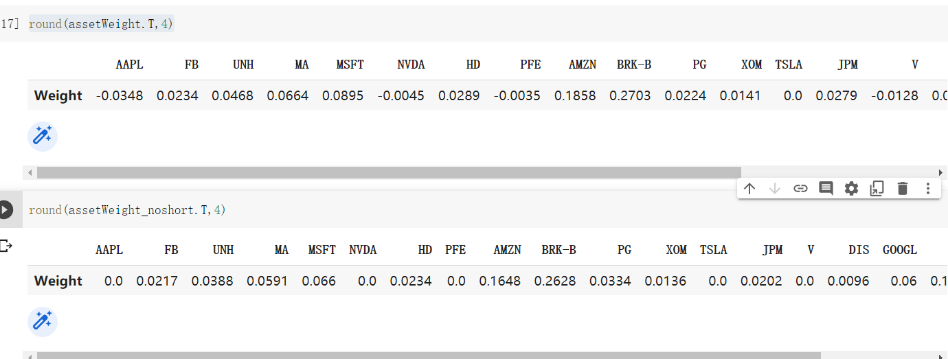
Problem3: Optimize Portfolio
No shortsell portfolio: weights which < 0 in shortsell portfolio becomes 0

